Slide 1
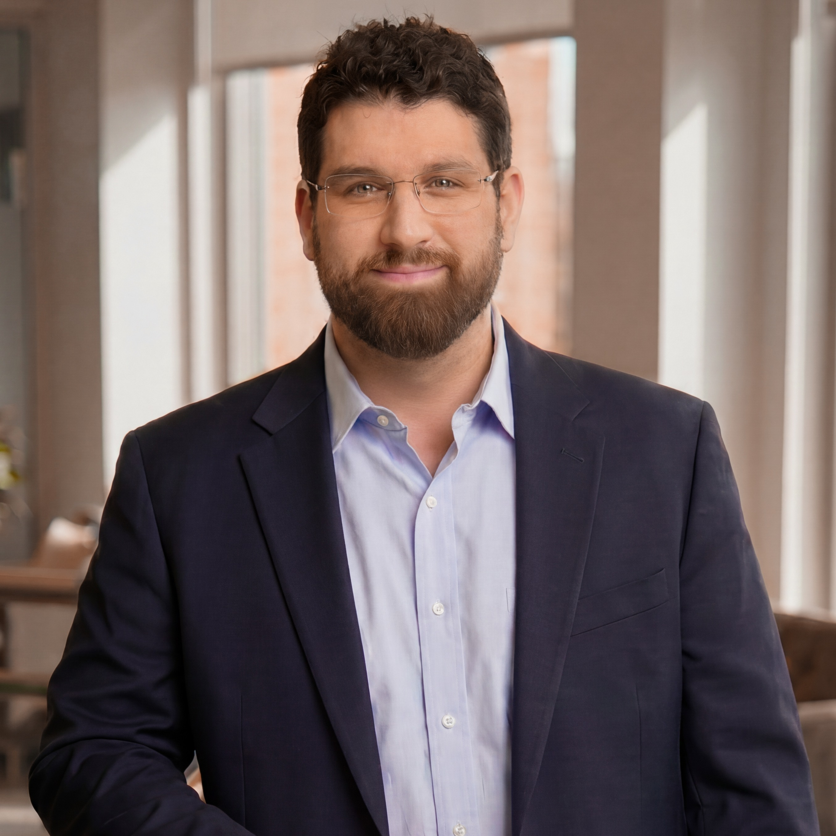
UNSCRIPTED SMALL BUSINESS • EPISODE PLAYBOOK
Trust, Not Clicks
The fractional Chief Communications Officer’s playbook — with Joshua Altman, Beltway Media.
Hosted by Jeremy Rivera • unscriptedseo.com

Slide 2
WHO
What a Fractional CCO Actually Is
Contractual, part-time, but fully integrated into your team.
A senior communications leader for a quarter of the hours — sometimes 5–10/month.
Brings marketing, branding, advertising & internal comms under one role.
The goal isn’t awareness for its own sake — it’s trust.
“We’re the expert at communicating your expertise.”

Slide 3
WHEN
Who Needs It — Solopreneur to 250
Solopreneurs who got stuck ‘owning’ marketing by default.
Founders & early hires who built the website and now run all things digital.
Fractional means you don’t buy more than you need.
Up to 100–250-person firms that scaled everything but comms.

Slide 4
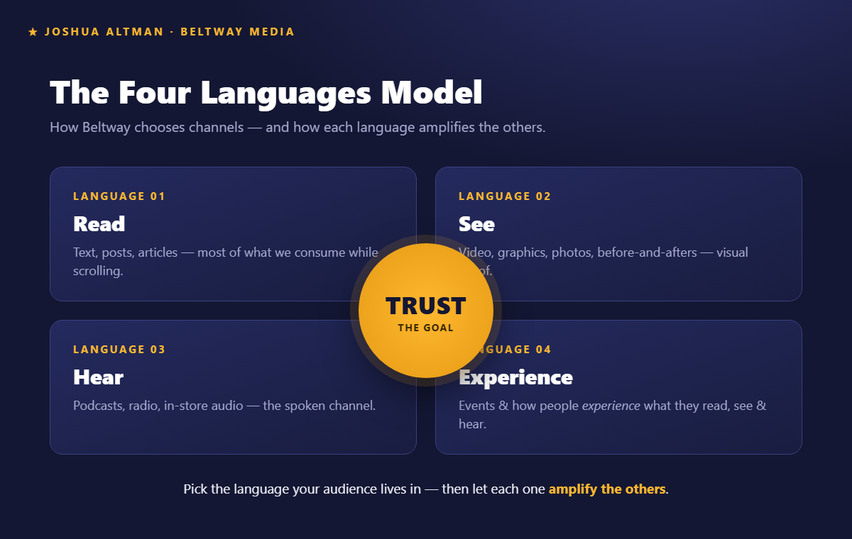
FRAMEWORK
The Four Languages Model
Read • See • Hear • Experience — each amplifies the others.

Slide 5
CONTENT
There Are No ‘Content Police’
Cadence is yours to set — one a week can be right.
Repurpose: one idea becomes a post on every channel.
Don’t overwhelm yourself or the client.
“These aren’t laws of nature. No one is gonna come after you.”

Slide 6
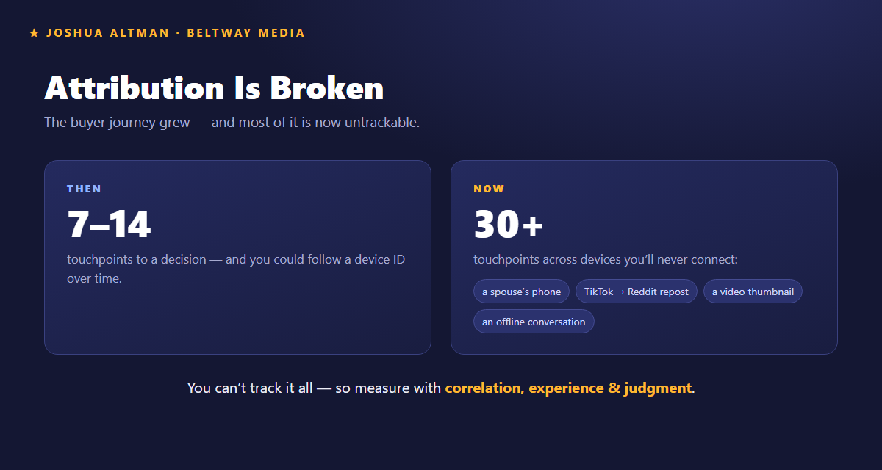
MEASUREMENT
Attribution Is Broken
7–14 touchpoints then — 30+ now, across devices you’ll never connect.

Slide 7
MEASUREMENT
What to Measure Instead
Correlation across signals: clicks, subscribers, leads, mentions rising together.
Run the experiment: drop all-but-one channel; watch leads & mentions.
Lean on experience, judgment & customer knowledge.
Sears grew for a century tracking by ZIP code.
“Businesses grew. The system worked without knowing how deep someone scrolled.”

Slide 8
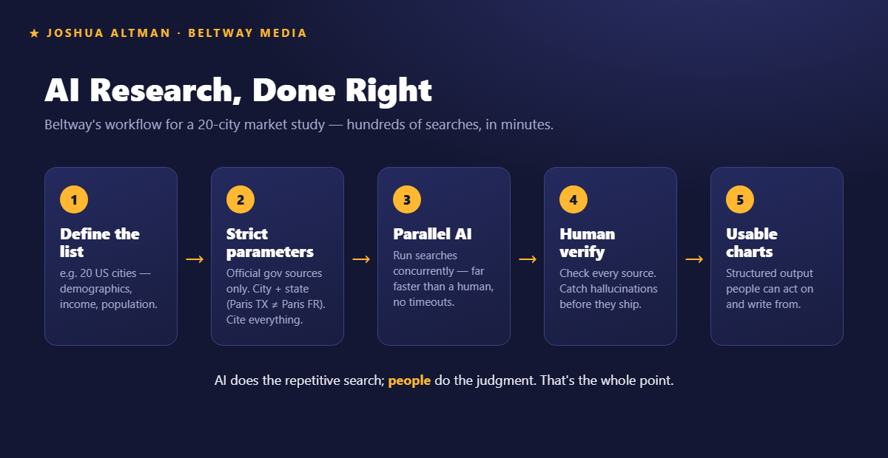
AI
AI Research, Done Right
Strict parameters → parallel → human verify → usable charts.

Slide 9
AI
Bots Are Best at Talking to Bots
Two audiences: human and machine — speak to both.
Let a bot fill keywords, metadata & schema so pages surface for machines.
Never ship final brand content without human editing — it hallucinates.
People handle the brand and the bigger ecosystem.
“Bots are really good at talking to other bots.”

Slide 10
Everything you produce should be useful.
🌐 Beltway Media — beltway.media
🧩 Free tools & quizzes — beltway.media/our-free-tools
👤 Joshua Altman — linkedin.com/in/joshuaialtman
🎧 The show — unscriptedseo.com

